Slide 1


Practical Training Session
INTERNATIONAL AGENCY FOR RESEARCH ON CANCER LYON - FRANCE
e-SMP

Slide 2

Introduction
Materials to practise
Exercise 1
Exercise 2
Extra exercises
Feedback exercises
Discussion exercises
Practical training session
IARC, Lyon - France
GloboDiet training:

Slide 3


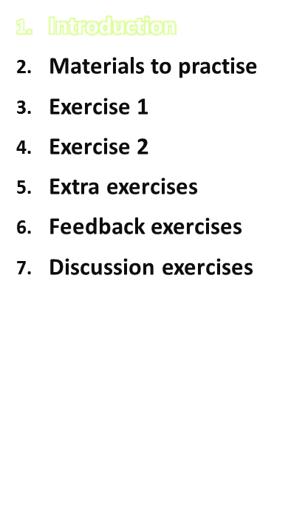
The trainees should have had a training on the basic GloboDiet (GD) concepts, terminology, and definitions prior to this practical training session
The trainees get a chance to practice using the 24h GD application via specific exercises during this practical session.
All exercises included in this presentation are designed for the English GD version → local examples should be provided for local training!
  Exercise 1: an example to get familiar with the quick list and the description part in GD application
  Exercise 2: examples of recipes to get to know different possibilities in handling recipes
  Extra exercises if time available
Practical training session
IARC, Lyon - France
GloboDiet training:

Slide 4
Introduction
It is crucial to practice on your own and in your own context with your own country-specific version of GloboDiet before organizing the training in your country.
Interviewers should be trained to handle specific local dietary habits – please consult the IARC to be sure to teach the ‘right & harmonized’ way.
Administer at least 5 different 24-h recalls and note your specific problems (home work)
Encountered problems should be mailed to: HuybrechtsI@iarc.fr
Practical training session
IARC, Lyon - France
GloboDiet training:

Slide 5
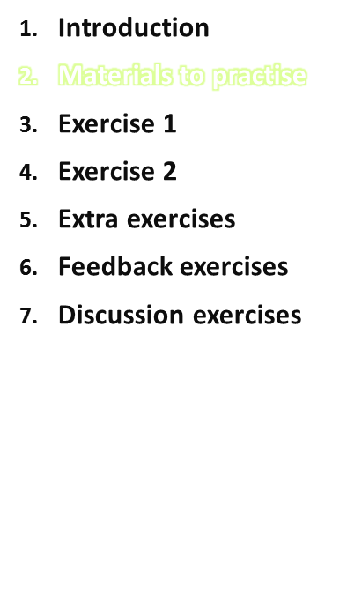
Interviewers should have the following materials at their disposal to conduct these exercises:
  Laptop on which GloboDiet has been installed
  Picture book, including shapes & household measures (to estimate portion sizes)
  GloboDiet user manual
  Appendices
  Exercises
  Slides of the training course
Practical training session
IARC, Lyon - France
GloboDiet training:

Slide 6
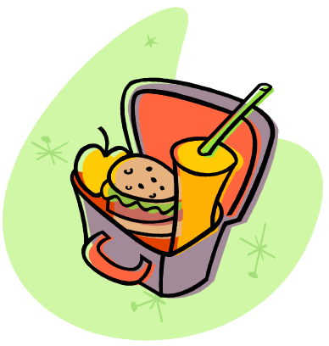
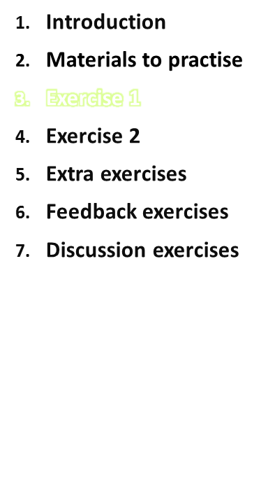

Exercise 1
Practical training session
IARC, Lyon - France
GloboDiet training:

Slide 7
Exercise 1 (General information)
Start GloboDiet, confirm date and choose the correct interview
name/number? (location Cambridge United Kingdom).
Participant: John Dawn, male (born 13-03-1989), 1.84m and 84 kilos
His subject code is 123456.
No diet, no special day
Recalled day wake up time: 8:00 AM
Next Day wake up time 8.30 AM
Practical training session
IARC, Lyon - France
GloboDiet training:

Slide 8
Exercise 1 (The recall)
Breakfast 8.30 AM at home
• 2 slices of white bread (oval). Both slices: as on shape S061, thickness 1.5 cm.
• spread with whole-fat unsalted butter (brand unknown) as on photo 58-2.
• 1 slice with whole-fat cheese (Kraft) hard, cow (choose same shape as the bread slice for quantifying the cheese!), thickness on bread as on photo 31-2 and
• 1 slice with jam n.s. (no fruit flavour specified), thickness as on photo 59-3.
• 1 carton (200 ml) orange juice commercial n.s.; liquid, not sweetened, not enriched
During morning at home 11.00 AM
• 1 cup of coffee with caffeine, 7/8 filled (H-50)
• Coffee creamers (creamers for hot beverages liquid) skimmed, Co-op brand, 1 cup (individual unit of 15 g)
• Sugar white, ½ teaspoon (H-17)
• 1 large chocolate chip cookie (commercial, fat unknown)
Lunch at home 13.15 at home
• 2 slices of wholemeal bread (shape S056, thickness 1 cm)
• 1 slice spread with whole-fat unsalted butter (brand unknown) thickness on bread same as breakfast - photo 58-1
• 1 slice spread with peanut butter thickness on bread as in P033 -3
• 1 breaded and fried chicken escalope (breast fillet) portion photo 42-2; served with salad (portion photo 8-2) and normal salad cream/dressing (1 sachet, but some dressing left on the plate)
• 1 cup of milk partially skimmed H47-2/3
Practical training session
IARC, Lyon - France
GloboDiet training:

Slide 9
Exercise 1 (The recall, part 2)
During afternoon 16.15 in the street
• Orange juice, the same as breakfast
• Peanuts dry roasted, photo 28-1
Dinner 19.00 at home
• Boiled potatoes photo 1-2 fried in olive oil and served with tomato ketchup (unknown amount)
• sausage beef, cooked with fat, photo 49-3
• spinach frozen, cooked photo 7-3
• apple whole with skin 2.5 inches Diameter
Has not eaten or drunk anything during the rest of the day.
No supplements used
To bed at 22.30 PM
Practical training session
IARC, Lyon - France
GloboDiet training:

Slide 10
Exercise 1 (Discussion)
Practical training session
IARC, Lyon - France
GloboDiet training:

Slide 11
Exercise 1 (General information)
New interview
Centre: England
General information participant: use F5 (list) or enter
Enter the day of recall (yesterday: 7:15) and time of getting out of bed today (8:30)
When entering the food consumption occasions, please be aware that the places of consumption might be different in your study!
Practical training session
IARC, Lyon - France
GloboDiet training:

Slide 12
Exercise 1 (Quick list)
Enter breakfast at 8.45
    Bread – related items linked to a single QLI
    orange juice
During morning 11.00
    Coffee – related items linked to a single QLI
    Cookie
Lunch 13.15
    Bread – related items linked to a single QLI
    Chicken with salad
    Milk
During afternoon 16:15
    orange juice
    peanuts
Dinner 19.00
    Potatoes –related items linked to a single QLI
    sausage
    spinach
    Apple
Be aware that the minutes may not be available in your project (then please round to the closest full hour)!
Practical training session
IARC, Lyon - France
GloboDiet training:

Slide 13
Exercise 1 (Describe and quantify)
Breakfast
  Bread, white: choose an applicable shape and thickness
    Another ingredient to be added for the quick list item? Y
    Butter …..
    …
    Any missing ingredients?
    Any fat left in the dish? (skipped as not applicable)
  Juice, orange
During morning
  Coffee with caffeine, add milk and sugar under the same QLI
  Cookie>> biscuit chocolate chip cookie 1 large
Lunch
  Bread with related items in the same QLI; for butter use F5-function = copy
  Chicken (breast fillet)
  Milk>> enter as told by participant
Practical training session
IARC, Lyon - France
GloboDiet training:

Slide 14
Exercise 1 (Describe and quantify)
During afternoon
  orange juice >> use F5 to copy
  Peanuts >> use photo
Dinner 19.00
  Potatoes>> cooked with fat (olive oil): 2 cooking methods → choose
      Another ingredient to be added? Y
      Tomato ketchup Heinz >> unknown portion size
      Association table: Y to potatoes
  Sausage>> cooked with fat, amount calculated automatically
  Spinach>> frozen, cooked
  Apple>> with skin, 2.5D use the ruler
Practical training session
IARC, Lyon - France
GloboDiet training:

Slide 15
End of the interview
Press “next interview step”
  Control energy and macronutrient
Press “next interview step”
  Feeding supplements...? No
Press “end interview”
  Do you want to save the interview? Yes
Practical training session
IARC, Lyon - France
GloboDiet training:

Slide 16
End of the interview
IMPORTANT: be aware that the interview time is registered for organizational and statistical reasons.
Therefore it is important to start the interview immediately after having entered “new interview” and save and exit the interview immediately after the dietary supplement screen!
Practical training session
IARC, Lyon - France
GloboDiet training:

Slide 17
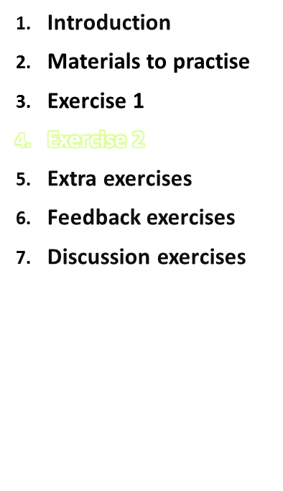
Exercise 2
Practical training session
IARC, Lyon - France
GloboDiet training:

Slide 18
Exercise 2
Scrambled egg: obtained from a restaurant (unknown name), 1 standard unit of a portion of 2 eggs [an example of an existing recipe that can be used as such and just quantified with existing quantification method]
Pizza: prepared at a friend’s place, recipe unknown. Topping: hard cheese, onion, and tomato sauce. Portion eaten = photo 74-3 [substitute and delete ingredients in an open recipe]
Salad nicoise (made at home): ingredients: 125 g canned tuna, 3 raw medium-sized tomatoes, 50 g black olives pitted, ½ raw cucumber , 200 g of raw French beans (with inedible part) were steamed, 2 boiled eggs, 2 serving spoons of Hellman’s French dressing. Portion eaten: Photo 515-3. [existing recipe, known]
Fish stew: [new recipe, homemade, known] was made beforehand and then reheated in a microwave
Practical training session
IARC, Lyon - France
GloboDiet training:
Notes:
Remark from the Netherlands: it might be difficult for the interviewer to estimate the water evaporated, therefore it could be better to recommend the interviewer to write a not so that all evaporation issues can be handled in the same way by the dieticians handling the notes afterwards.

Slide 19
Exercise 2
Fish stew: [new recipe, homemade, known] was made beforehand and then reheated in a microwave
2 soup spoons of olive oil
1 small onion, chopped
1 package of frozen cod fillet (400 g)
1 average red pepper, in slices
1 small tin of tomato puree
200 ml water (initial amount)
2 heaped soup spoons sunflower seeds
½ a package of fresh parsley (30 g), chopped
Preparation
Heat the oil and stir in the onion. Add the cod and stir for 1 minute. Add the pepper, tomato and water. Cook on a slow fire for ±20 minutes uncovered. Add salt and pepper. Sprinkle with parsley.
Portion size: P108-3 (when using the UK version, this picture could be used to make it easier for the respondent and the grams could be taken from the list in front of the picture book and entered manually in grams)
Practical training session
IARC, Lyon - France
GloboDiet training:

Slide 20
Exercise 2 (Fixed recipe)
Scrambled eggs
Go to recipe list
Select ‘scambled eggs’
Commercially prepared
Unit 1x
Save recipe F4
Practical training session
IARC, Lyon - France
GloboDiet training:

Slide 21
Exercise 2 (Recipe with substitution)
Pizza with cheese and tomato>> hard cheese is used instead of cheddar
Go to recipe list and select ‘Pizza with cheese and tomato’
Made at friend’s place
Recipe unknown
Quantify the portion 074-3 then
Substitute ‘cheddar cheese’ for ‘hard cheese’
Save the modified recipe
Practical training session
IARC, Lyon - France
GloboDiet training:

Slide 22
Exercise 2 (Recipe adapted to participants information)
Salade nicoise
Select recipe
Homemade recipe known
Quantify the consumed portion
Adapt the recipe to your own information
Practical training session
IARC, Lyon - France
GloboDiet training:

Slide 23
Exercise 2 (New recipe)
Fish stew
Go to recipe list:
2 possibilities:
    Adapt a recipe
    Enter a new recipe
Enter the ingredients and describe and quantify
  Be careful with the water used for cooking: some will be evaporated
  Note that the cooking oil has to be listed as an ingredient, it is not automatically calculated, linked to the fried cod
Practical training session
IARC, Lyon - France
GloboDiet training:

Slide 24
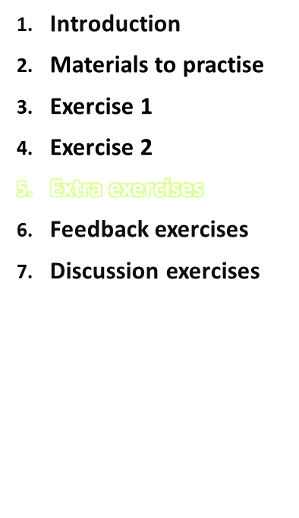
Extra exercises
Practical training session
IARC, Lyon - France
GloboDiet training:

Slide 25

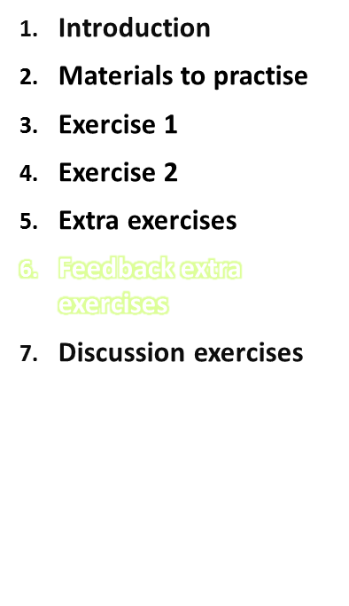
Outline
Feedback extra exercises
Practical training session
IARC, Lyon - France
GloboDiet training:

Slide 26
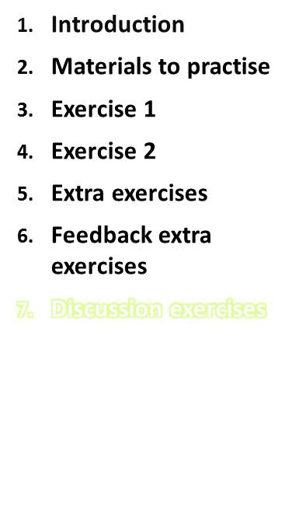
Discussion exercises
Practical training session
IARC, Lyon - France
GloboDiet training:
Notes:
Remark from the Netherlands: dieticians/interviewers should always remember that they need to considered the fat consumed in recipes and not the fat that was used (e.g. a big piece of butter to bake a hamburger → the respondent won’t eat all the butter added in the recipe). If the interviewer is unsure about the amount of fat that was taken up during the recipe he/she can always open an existing recipe to check or he/she should add a note!

